Slide 1
Deep Learning
Project 3
Paritosh Goel , Muhammad Tahir

Slide 2
Data Preprocessing
Stratified Sampling
Used sklearn - train_test_split function
train_test_split(images_vector, labels_vector, test_size=0.25, stratify=labels_vector, random_state=seed)

Slide 3
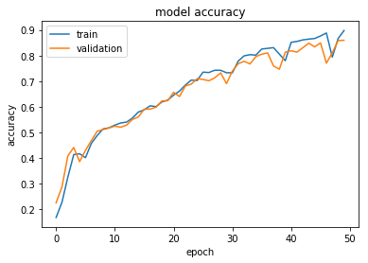
Model
Layers - 1 (125 nodes)
Batch Size - 2000
Epochs - 50
No of Layers - 1
1st Layers - 125 nodes
epochs=50 , batch_size=2000

Slide 4
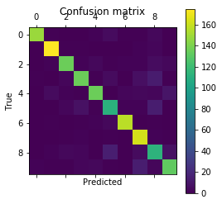
Test Data - 25% of original data set
Test accuracy: 0.86

Slide 5
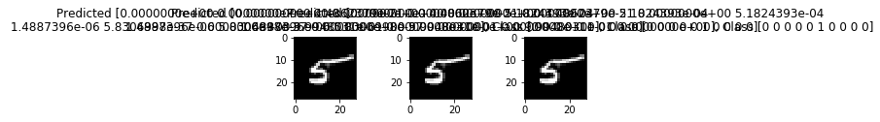
Samples

